Slide 1
Alumni Video Generator
Kieran Dang, Brian Chaput, Ryan Harang

Slide 2
The Foundation for WWU and Alumni
Key funding vector for WWU
Supports scholarships, departmental events, other events not covered by government funding
WWU Give Day 2025
CS department generated $13,143 in 2025
One of the largest single-department contributions in terms of total amount and number of donors

Slide 3
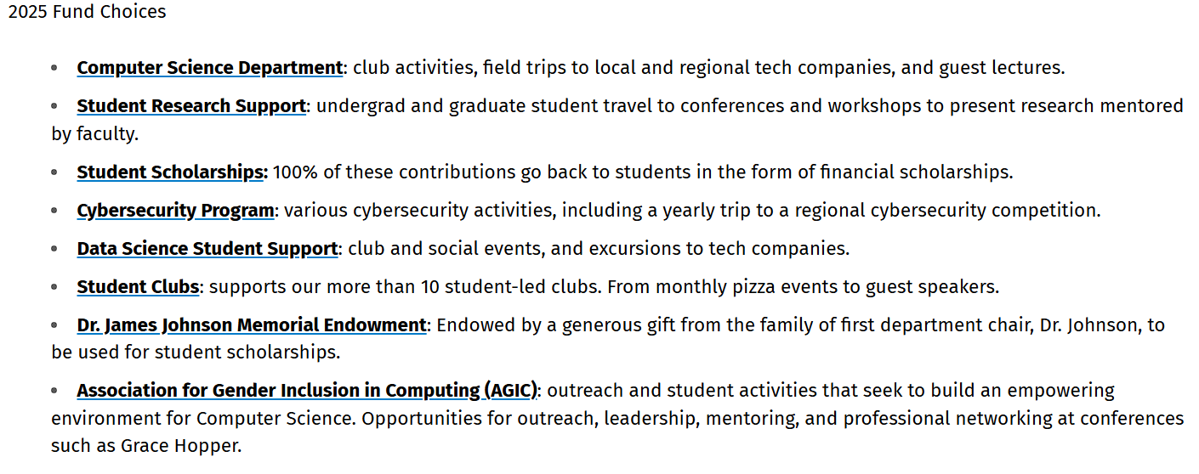

Slide 4
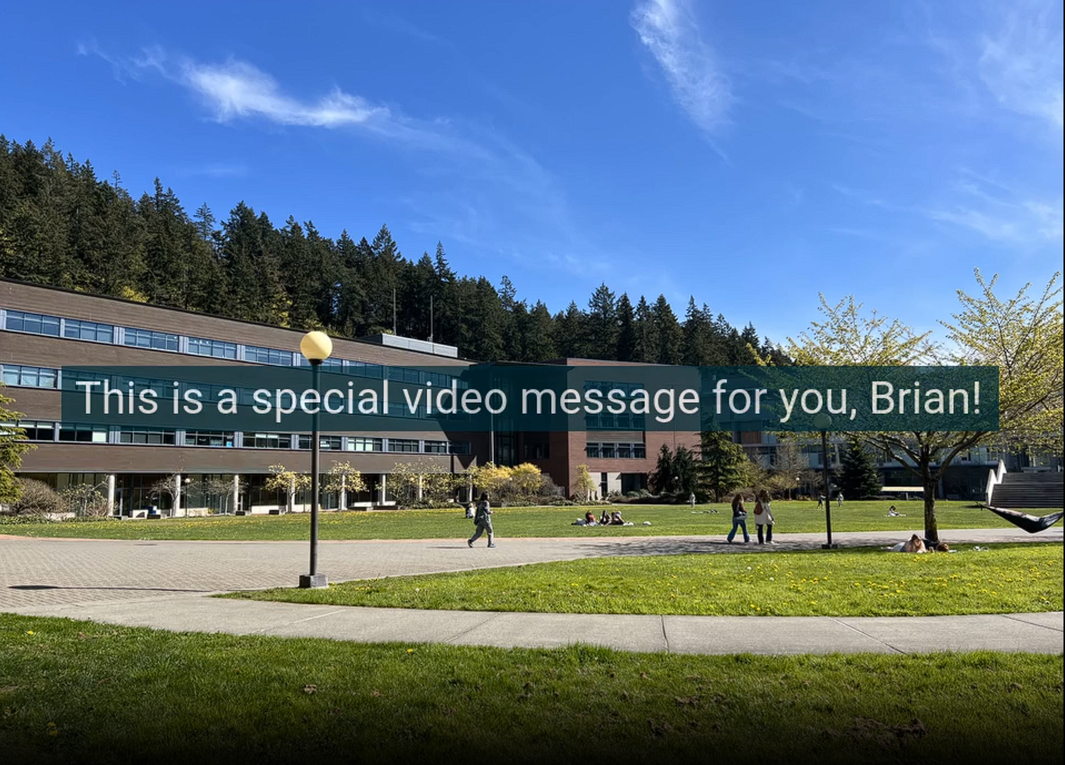

Slide 5
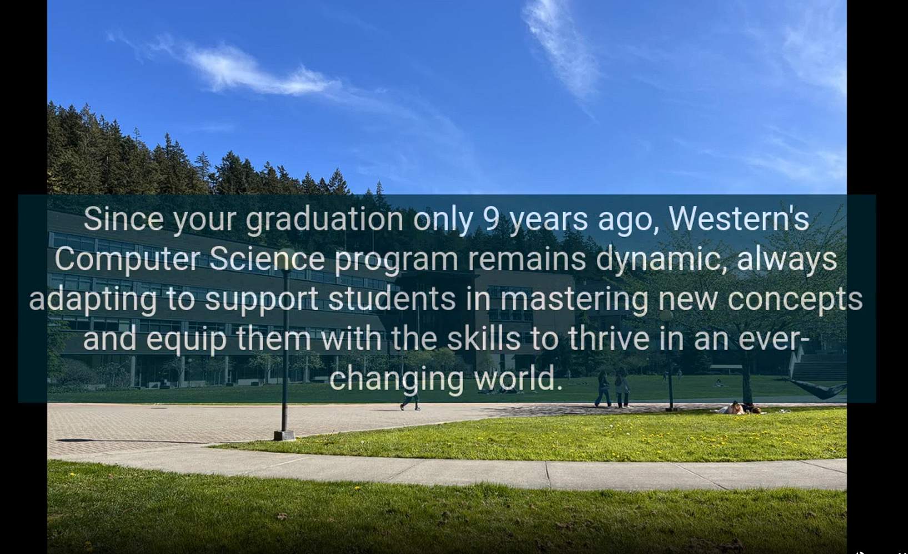

Slide 6
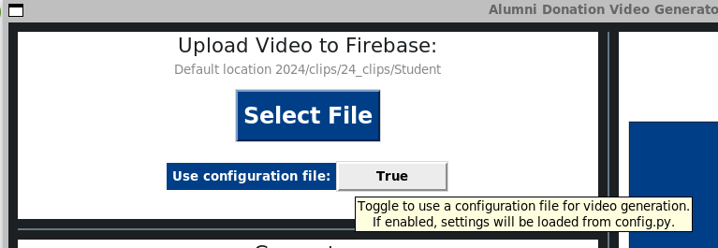
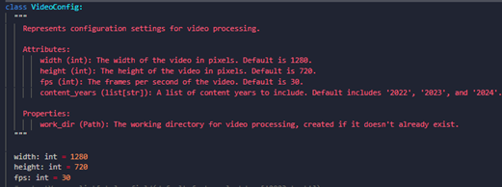
Goal of the GUI:
Simplify the video generation process and extend the weave programs functionality.
A key aspect of making unique, custom videos is adding new content to be used.
Simplified the process of adding new content to be used in videos.
Videos can be uploaded directly to the projects remote storage directory to be used in generating new videos.
A configuration file uploads the video clip in the proper format to be used in our program.

Slide 7
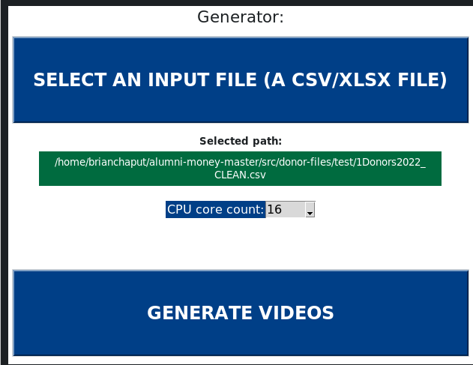
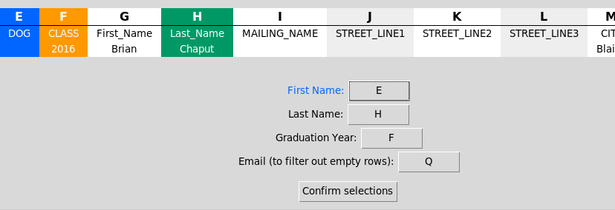
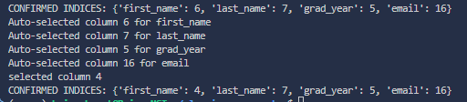
GUI: Spreadsheet Selection Interface
The GUI provides an interface for selecting a spreadsheet with alumni data.
After selecting a file, a preview window opens and columns are automatically selected.
The user is then prompted to verify and change any columns that are incorrect.

Slide 8
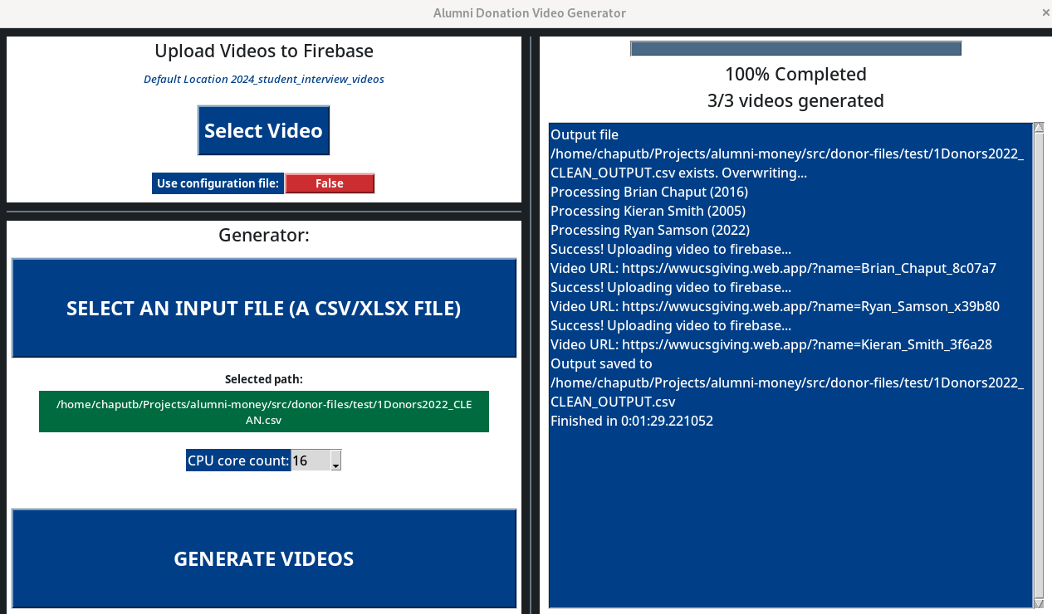
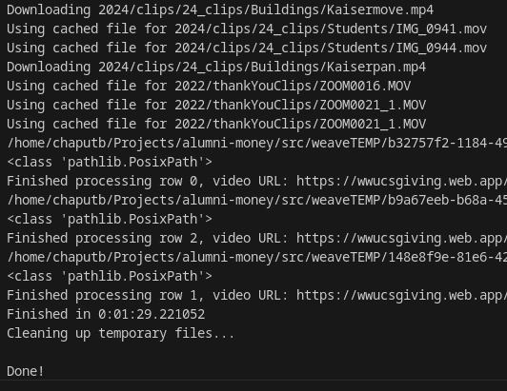
GUI: Video Generation Process
After selecting a spreadsheet, the program will generate videos that are uploaded to the projects remote storage.
The videos are built with custom video clips and text chapters based on the year that they graduated.

Slide 9
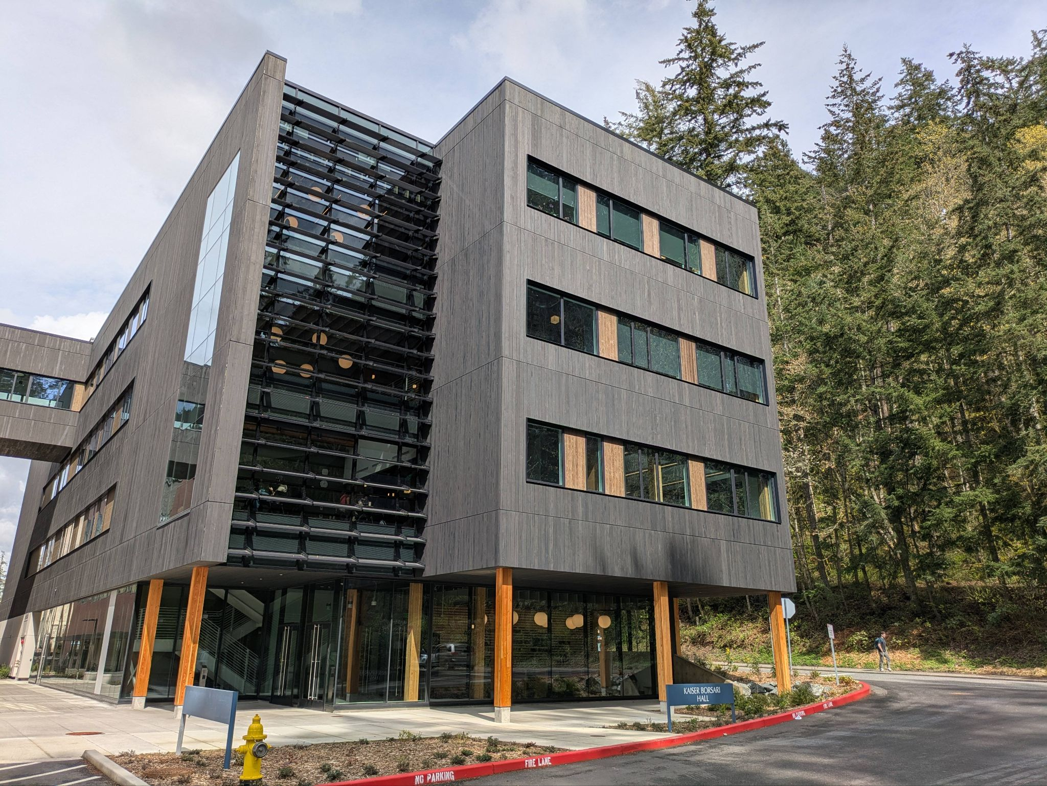
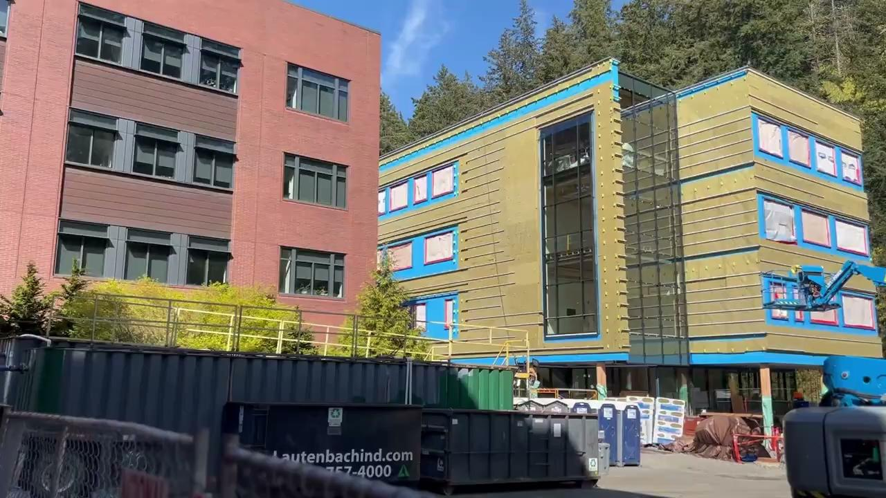
Video Updates
Updated information on Kaiser Borsari
Added new images and clips

